Slide 2
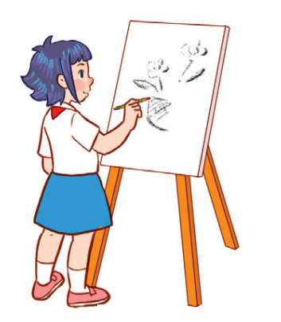
Unit 8
Period 2

Slide 3
Contents
1
Warm-up and review
2
3
4
Listen and tick or cross.
Look, complete and read.
Let’s play.
5
Fun corner and wrap-up

Slide 4
Warm-up and review
Warm-up and review
1
1
1
Game: Who’s faster?

Slide 5
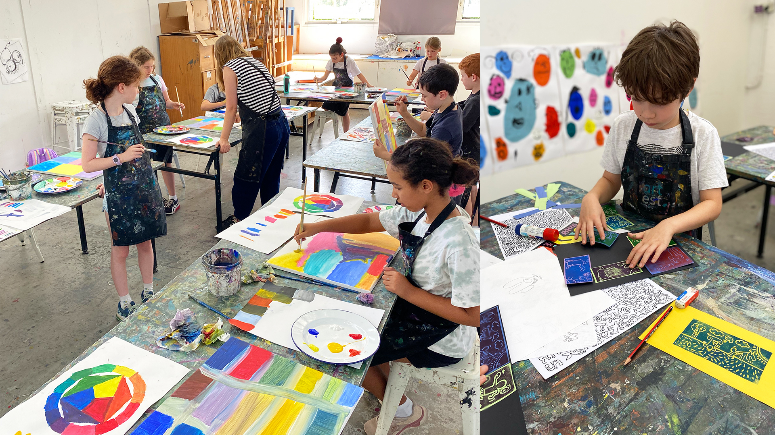
LOOK AT THE PICTURES, SAY THEN SPELL!
art

Slide 6
PE

Slide 7
music

Slide 8
IT

Slide 9
Listen and tick or cross.
2
2

Slide 11
✓
✗
✓
✗

Slide 12
Look, complete and read.
3
3

Slide 14
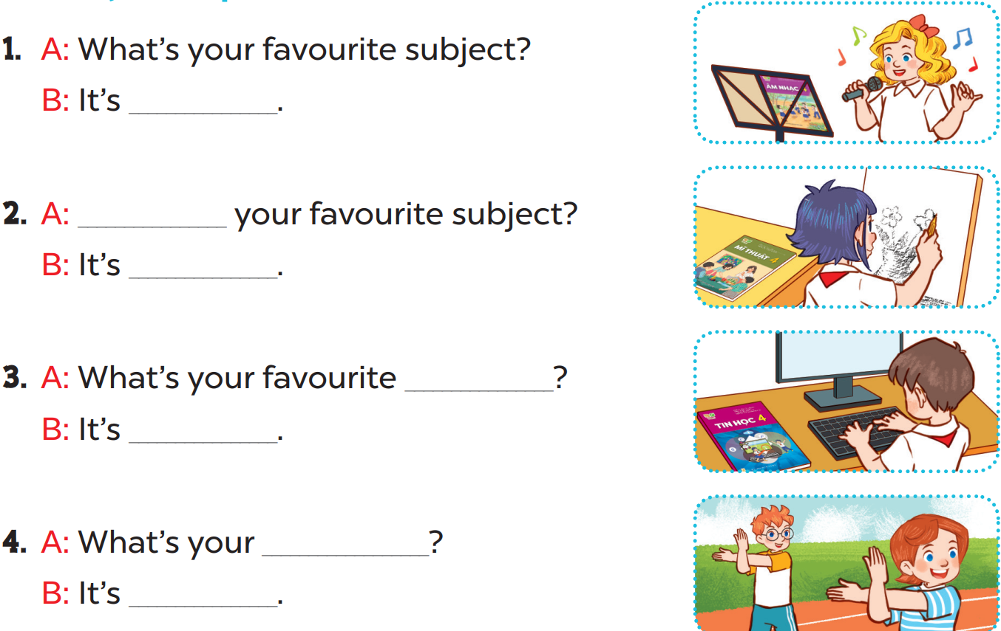

Slide 15
music
What’s
art
subject
IT
favourite subject
PE

Slide 16
Let’s sing.
4
4

Slide 19
Fun corner and wrap-up
5
5
Game: Anagram

Slide 20
Make a sentence. What’s missing?
E
C
T
I
I
R
S
U
U
T
O
M
V
M
S
C
A
E
U
J
B
Y
F

